Slide 1

Marketing Data Solution

Slide 2
National Military Family Association
Purpose & Agenda
Purpose
This brief offers an overview of Team 4’s database management system project conducted on behalf of the National Military Family Association
Agenda
About the Sponsor
Current Data Problem
Constraints and Limitations
Solution and Objectives
Key Tasks (Deliverables)
DBMS Mock-ups
Conclusion & Way Ahead

Slide 3
National Military Family Association
About the National Military Family Association: Industry, Services & Functions
The National Military Family Association (NMFA) is the leading 501(c)(3) non-profit association serving the families of the currently serving, veteran, retired, wounded or fallen members of the Army, Navy, Marine Corps, and Air Force, by providing:
Advocacy;
Programs that enrich family well-being, and;
Spousal educational scholarships.

Slide 4


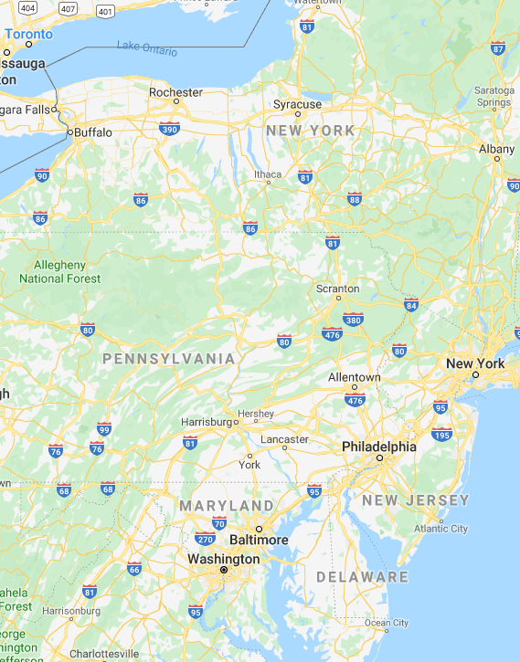






National Military Family Association
About the National Military Family Association: Industry, Services & Functions
Physically located in Washington D.C.
Supported by:

Slide 5
National Military Family Association
About the National Military Family Association: Industry, Services & Functions
NMFA has a full-time staff of 22 people
Project sponsor was the Marketing Department
Executive Director
Government Relations
Military Family Programs
Advancement
Marketing
Development
Our Data Problem

Slide 6
National Military Family Association
What’s the Problem?
The Marketing department is responsible for advancing the NMFA brand
Increase awareness of the efforts undertaken by NMFA on behalf of its constituents.
As a result increased donations, and in turn, increased ability for NMFA to support military families through advocacy and programs.
To accomplish this, the marketing department must communicate with different groups of people (both internal and external) that engage with NMFA: donors, subscribers, and members – “Participants”
The organization lacks a single database where external stakeholders Participants (donors, subscribers, and members) can be processed, stored and managed to meet the needs of the organization.

Slide 7




National Military Family Association
What’s the Problem?
Military Family Programs
Marketing
Development
Each Department has its own database management system
The Data Problem
Volunteers, Program & Scholarship applicants and recipients
Subscribers
Donors and Members
Spreadsheets managed by a small staff
“All-in-one online marketing platform”
Email marketing
“Comprehensive cloud-based fundraising and donor management software solution built specifically for nonprofits”

Slide 8
National Military Family Association
Project Constraints and Limitations
Sponsor Constraints
Solution must be simple; not require non-resident expertise
The development team will maintain their existing data system (Raiser’s Edge)
The marketing team will continue to use Constant Contact for the distribution and recording of emails
Project Limitations (by us)
Data integration problem will not be addressed; but system created can serve as a model/proof of concept
Our project must be complete by 01 December 2019, can provide out brief to the sponsor no earlier than 20 December 2019

Slide 9
National Military Family Association
Solution and Objectives
Goal: Develop a single marketing database solution that:
Allows the marketing team to consolidate “participants” into one DBMS
Provide a schema organized in such a way that the marketing team can track marketing campaigns and the involved participants
Provide the tools (forms, reports, queries) that allow for the segmentation of the database (query) to better support the Programs and Development departments
Objectives:
Increase the effectiveness of marketing activity through relevant marketing communications
Provide better management of marketing programs and efforts
Effectively measure the impact of marketing to subscribers, donors and members

Slide 10
National Military Family Association
Key Tasks
Key Tasks:
Create the business rules needed to properly record “participant” in the database
In coordination with the sponsor, develop business questions the system must help answer
Develop and validate the Entity Relationship Diagram, the data dictionary, the physical model, and initial data entry
Develop tools (forms, reports, etc.) that immediately help the marketing team, and provide a proof of concept for the organization to use in future DBMS development
Notes:
The data integration required across the Development, Programs, and Marketing departments requires an extensive Data Lake/Data Warehouse architecture with an extract, transform, load (ETL) capability and it exceeds the scope of this project. Our proposed system will focus on addressing the challenges faced by the Marketing department and will provide a proof of concept for NMFA to consider as a model for a broader database solution. Our system will result in the Marketing manager being able to manage targeted messaging for specific people in the database. It will allow them to build records for each marketing campaign they develop, as well as glean insights from marketing and donation campaign trends to assist the Development and Programs departments.

Slide 11
National Military Family Association
Key Task #1: Business Rules (1 of 2)
Number one challenge… “who is who?”
Regular Folks
Donors
Military Family
Subscribers
Members
School/Program Recipients

Slide 12
National Military Family Association
Key Task #1: Business Rules (cont.)
A “donor” is defined as a person that makes a financial contribution to the organization.
A “subscriber” is defined as a person that has opted in to receive emails from the organization by providing their email address on the sign-up form on the NMFA website.
A “member” is defined as a person that makes a financial contribution to the organization and elects to be considered a member.
A “volunteer” is any person that has elected to assist NMFA.
The term “participant” is the general term that will be used to identifying any individual that is included under any of the following statuses: “donor”, “subscriber”, “member”, and “volunteer”.
A “ program participant” is a person that has/ is selected to participate in an NMFA program. No “NMFA status” is required to be a recipient.
A “scholarship recipient” is any person meeting scholarship specific criteria that has/ is selected to receive a NMFA scholarship. A recipient is not required to be a participant.
A “donor” does not have to be a member nor a subscriber but could be both.
A “member” must also be a “donor” since donating is a prerequisite to become a member, and a “member” could also be a “subscriber”, but it is not required.
A “constituent” is/are all military families covered by the broader advocacy goal of the organization (no action is required buy constituents)
The Marketing department is the authoritative administrator of the subscriber database.
The Development department is the authoritative administrator of the donor and member database.
The system of record the Development department uses to manage fundraising and donation data is Raiser’s Edge (a comprehensive cloud-based fundraising and donor management software solution)
The Programs & Scholarship department is the authoritative administrator of the program recipient and volunteer database
Marketing email distribution lists will be catalogued for historical purposes each time an email is sent (through Constant Contact – the cloud-based email marketing distribution management system currently used by the organization.)

Slide 13
National Military Family Association
Key Task #2: Business Questions
How many donors/members/etc. do we have?
Which donors participated in a given donation activity?
What is the average donation for a given Campaign ID?
How many emails have we sent to donor X?
How many members live in city X?
In what state do most of our members live?
How many subscribers are also members?
Which subscribers are donors?
Which subscribers are in the military?
When was the last time we sent an email to subscriber/donor X?

Slide 14
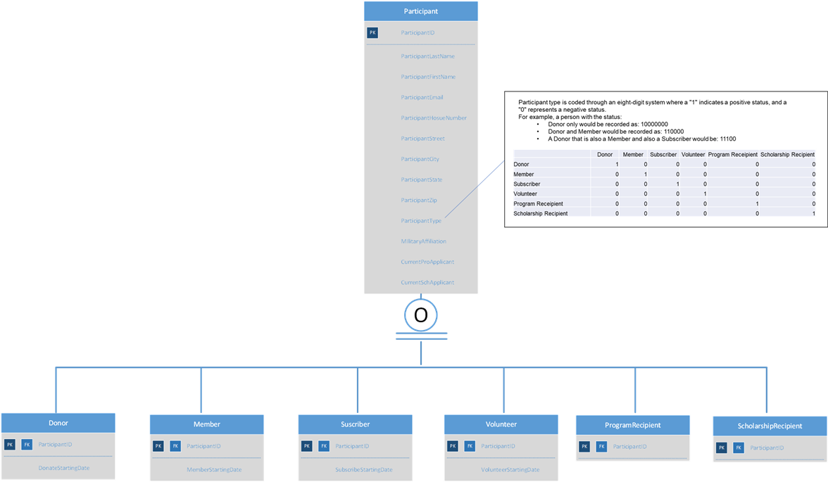
National Military Family Association
Key Task 3: ERD, Data Dictionary, etc.

Slide 15
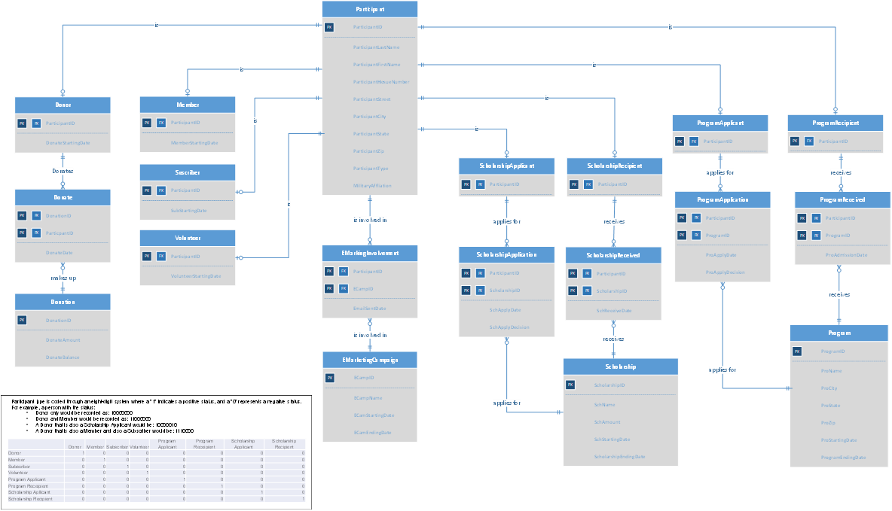
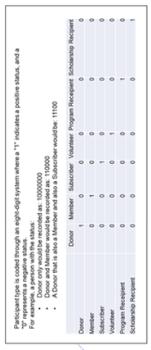
National Military Family Association
Key Task 3: ERD, Data Dictionary, etc.

Slide 16
National Military Family Association
What’s the Problem?
Military Family Programs
Marketing
Development
Each Department has its own database management system
The Data Problem
Spreadsheets managed by a small staff
“All-in-one online marketing platform”
Email marketing
“Comprehensive cloud-based fundraising and donor management software solution built specifically for nonprofits”

Slide 17
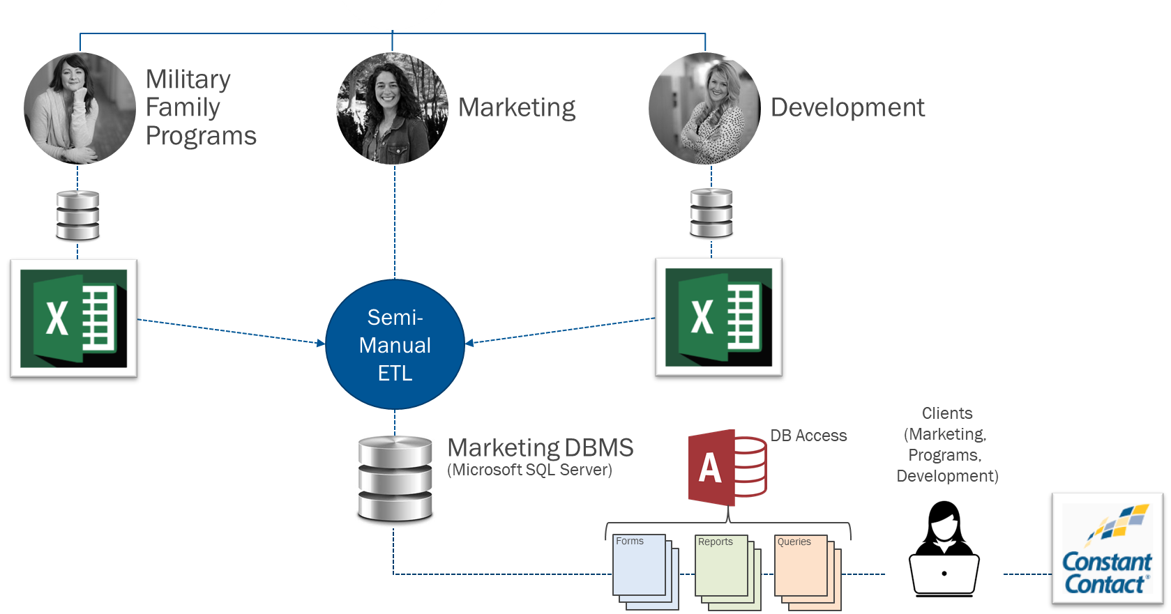
National Military Family Association
Key Task 3: Database System Infrastructure.

Slide 18
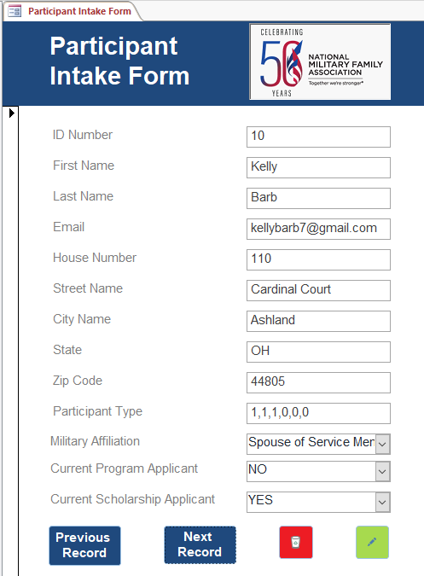
National Military Family Association
Key Task 4: Preparation Work
Notes:
Existing donors and members
Overtime
Checking with other departments
Identify the gap
Keep data updated

Slide 19
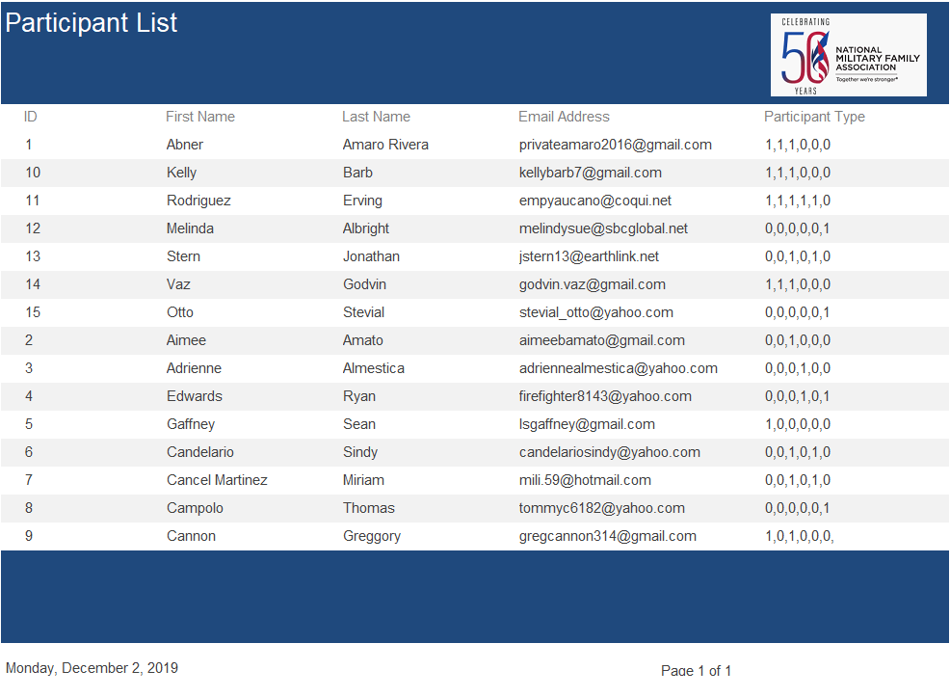
National Military Family Association
Key Task 4: Preparation Work
Notes:
Existing donors and members
Overtime
Checking with other departments
Identify the gap
Keep data updated

Slide 20


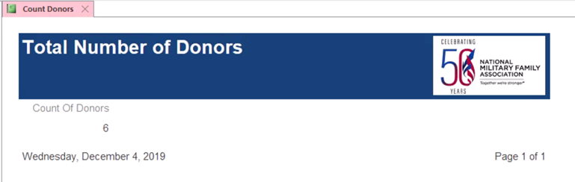
National Military Family Association
Key Task 4: Forms and Reports (1 of 10)
Q1: How many Donors/Members/etc. do we have?
Notes:
Existing donors and members
Overtime
Checking with other departments
Identify the gap
Keep data updated

Slide 21
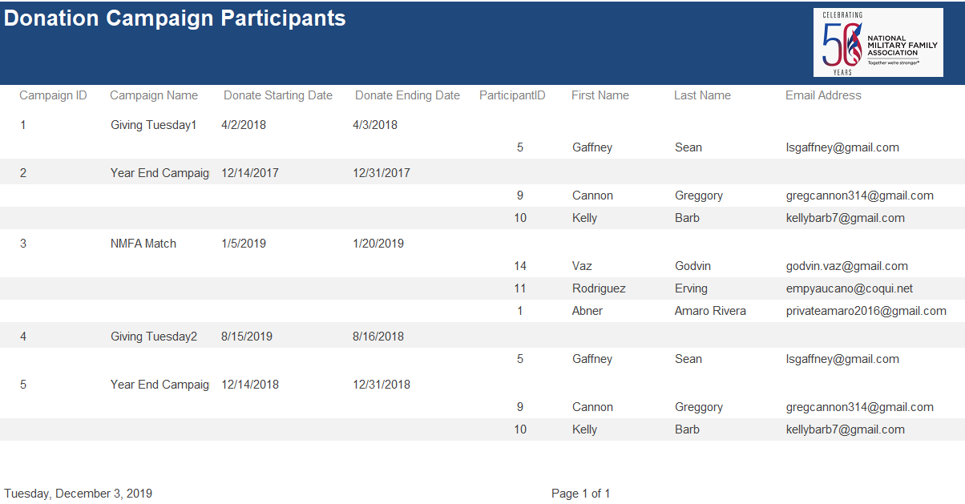
National Military Family Association
Key Task 4: Forms and Reports (2 of 10)
Q2: Which donors participated in a given donation activity?
Notes:
Number of donors in recent donation campaign
Know the percentage of donor that are actively engaged
Provide some basic feedbacks to the development team
Marketing department – do the follow up email/thank you email
Identify people who have donated before – do differentiated marketing
Increase their incentives to keep participating in future donation events

Slide 22
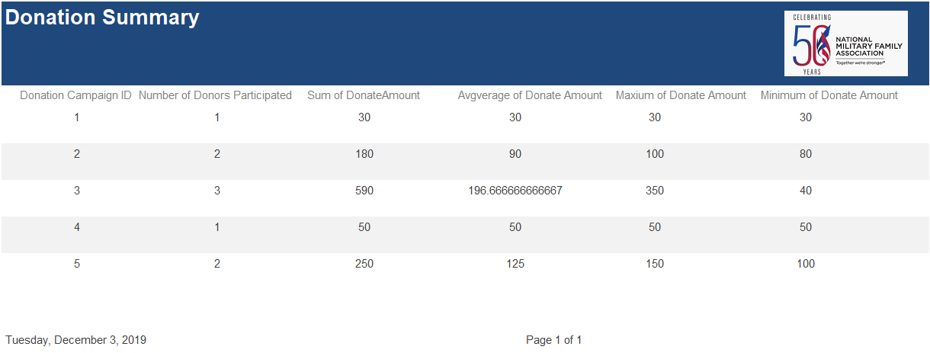
National Military Family Association
Key Task 4: Forms and Reports (3 of 10)
Q3: What is the performance of each donation campaign
Notes:
Direct goal: Increase awareness of the efforts undertaken by the organization
Intermediate goal: increased donations
Ultimate goal: increased ability for NMFA to support military families
Evaluate the performance of any donation campaign
Convenient for them to do the Comparison
Have a sense of which donation campaign is the most successful or the least successful
So that they can Look into the campaign and find out the important factors

Slide 23
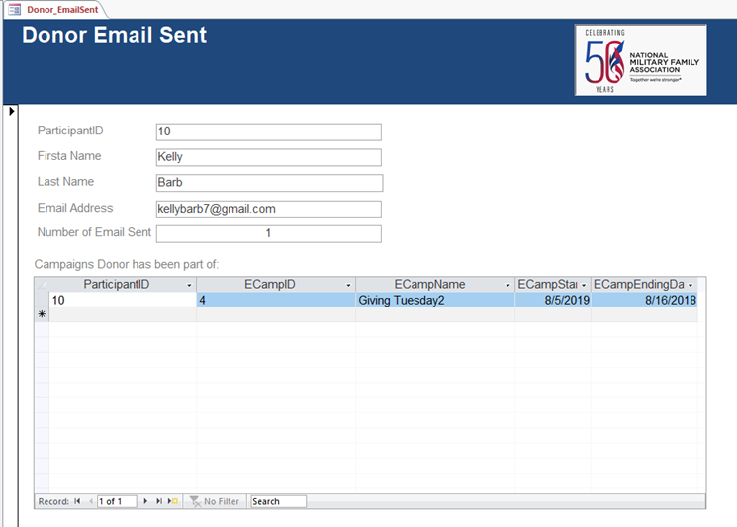
National Military Family Association
Key Task 4: Forms and Reports (4 of 10)
Q4: How many emails have we send to donor X?
Notes:
Example of finding out some factor
Scan through the table to check If the marketing department have missed contacting any donor
React quickly to take make-up actions

Slide 24
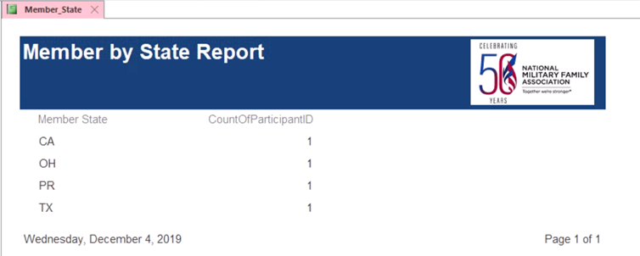
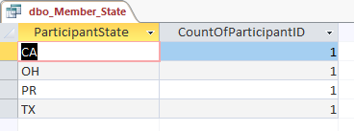
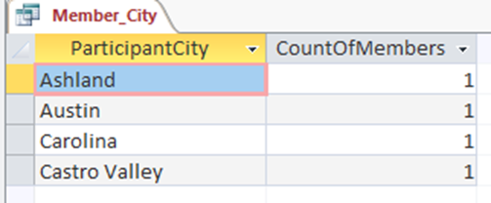
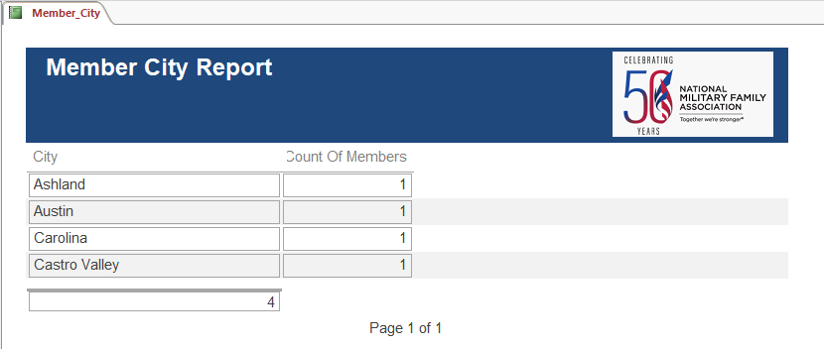
National Military Family Association
Key Task 4: Forms and Reports (5 & 6 of 10)
Q5: In what state so most of our members live?
Q6: How many member live in city x?
Notes:
Often when then organization is planning an offline event
They will think about where they should hold the event
Choosing an are that has relatively more members might bring the event more audiences
Member are the people who have donated before and signed up to be member in the organization’s website
This group of members is considered to be very valuable and high initiative to participate in the organization’s activities
Moreover, the geological distribution members can help manager identify areas that need more marketing efforts to be put in
For example, increasing the marketing budget for the area that has the most members to enhance the local advantages
Or increasing the marketing budget for the area that has the least number of member to reach a balance among different areas
Idea for improvement: State – group; Subgroup – members

Slide 25
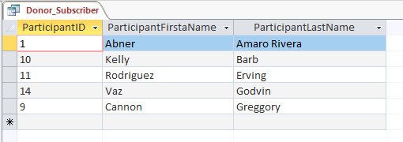
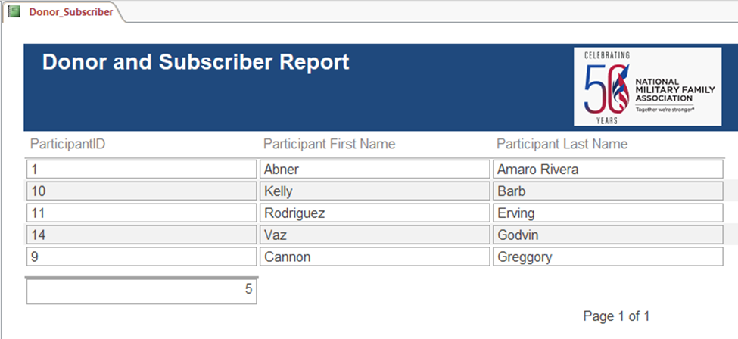
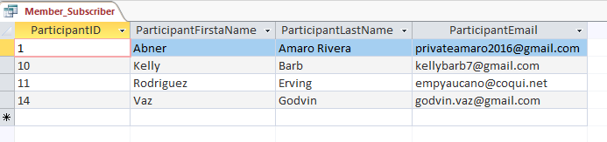
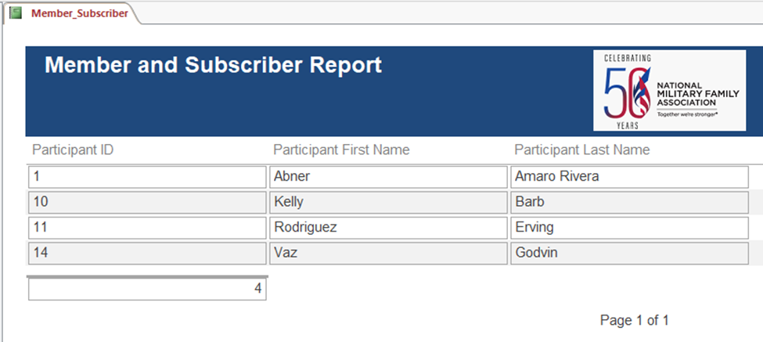
National Military Family Association
Key Task 4: Forms and Reports (7 & 8 of 10)
Q7: Which subscriber are donors?
Q8: How many subscribers are also members?
Notes:
Reivew:
A “donor” is defined as a person that makes a financial contribution to the organization.
A “subscriber” is defined as a person that has opted in to receive emails from the organization by providing their email address on the sign-up form on the NMFA website.
A “member” is defined as a person that makes a financial contribution to the organization and elects to be considered a member.
Direct goal: Increase awareness of the efforts undertaken by the organization
Intermediate goal: increased donations
Ultimate goal: increased ability for NMFA to support military families
Compare the result to the
Number of donor
Number of subscriber
To take one step further, we can do a left join and right join to find out
Which subscriber are not donor
Which subscriber are not members

Slide 26
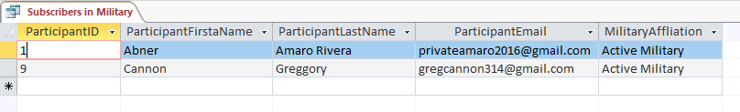
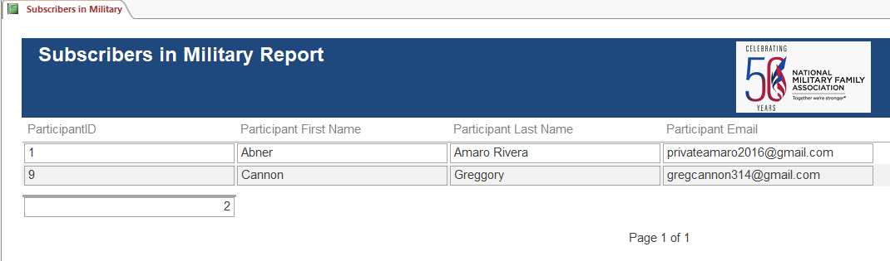
National Military Family Association
Key Task 4: Forms and Reports (9 of 10)
Q9: How many subscribers are in the Active Military?
Notes:
Give supports to military family
Not calling them to donate
We have a basic nee to differentiate this group of subscribers from others
Mainly, we send program info to this group of subscriber

Slide 27
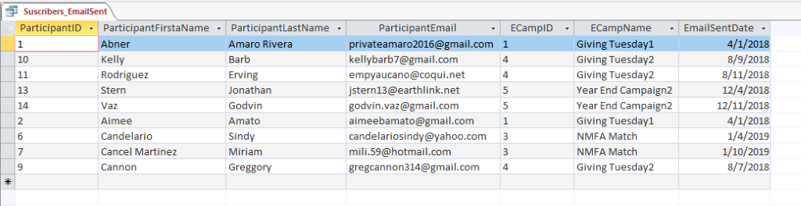
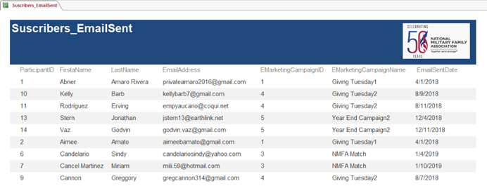
National Military Family Association
Key Task 4: Forms and Reports (10 of 10)
Q10: When was the last time we sent an email to subscriber X?
Notes:
Give supports to military family
Not calling them to donate
We have a basic nee to differentiate this group of subscribers from others
Mainly, we send program info to this group of subscriber

Slide 28
National Military Family Association
Conclusion & Way Ahead
Conclusion & Way Ahead
Notes:
Give supports to military family
Not calling them to donate
We have a basic nee to differentiate this group of subscribers from others
Mainly, we send program info to this group of subscriber

